Slide 1
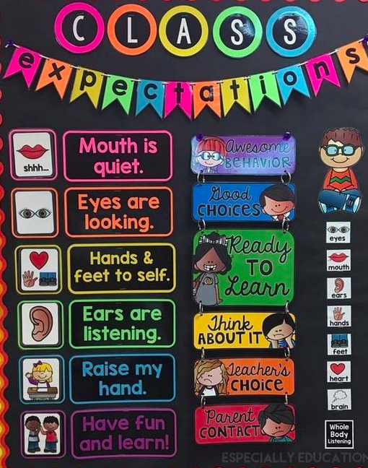
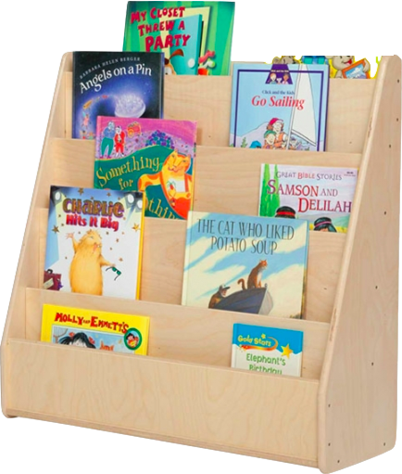
Welcome to Mrs. Marchica’s 1st Grade Class!
Registration Day 2020

Slide 2
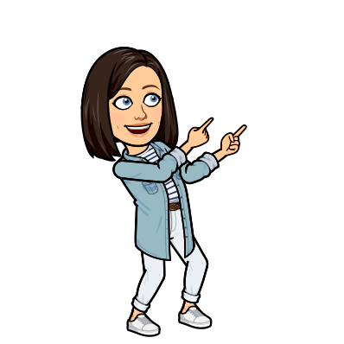
The Basics
Rodney B. Cox Elementary
Traditional Classroom Environment
Email: aricard@pasco.k12.fl.us
Phone #: (727) 437-2099 call or text or message through Class Dojo (more info to come later ☺)

Slide 3
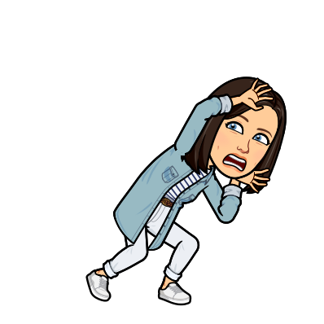
Safety
Students MUST wear a mask to school. Have spare in backpack just in case.
Water Bottles
One way hallways
Reducing # of students in any location
Increased sanitation
If you have ANY questions or concerns, please contact our administration (Tiffany Gocsik or Kimberly Natal)

Slide 5
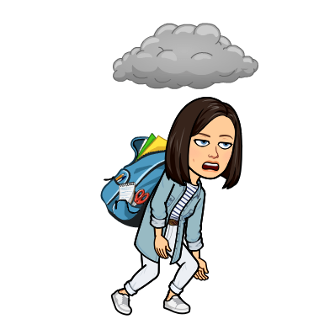
Supplies
The supply list for this year can be found on our school website.
https://rbces.pasco.k12.fl.us/wp-content/uploads/rbces/2020/07/Supply-List-1st-grade-003.pdf
I am MOST in need of pencils, erasers, plastic 3 prong folders, baby wipes, dry erase markers, glue sticks, tissues, earbuds, hand sanitizer, index cards, markers, 1 or 2 in binder, backpack, gallon/sandwich Ziplock bags

Slide 6
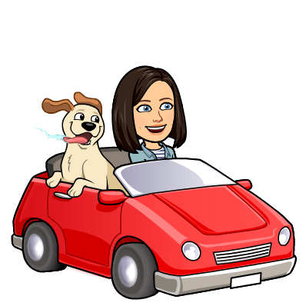
Transportation
Bus Routes are available on the parent portal
Car Tags are distributed TOMORROW (Friday 21st) from 10 a.m. to 1 p.m. at the CARLOOP. If you do not have a car tag on Monday when picking up your child you will have to wait and be verified before your child is released to you.
Take a few minutes now to ask each parent how their child is going home on 1st day and thereafter

Slide 7
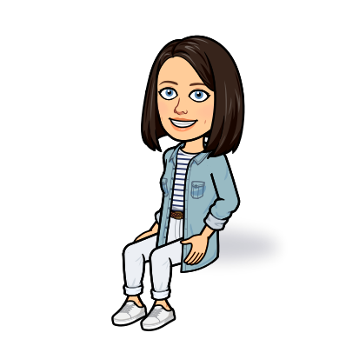
Parent Portal and Student Fees
All grades and communication related to student progress is done through the parent portal only. Call the office or visit our website for directions on starting your parent portal account
Student fees of $29 can be paid online or by check. All students whose fees are paid by September Student fees paid by September 11th will receive a free RBCES t-shirt.

Slide 8
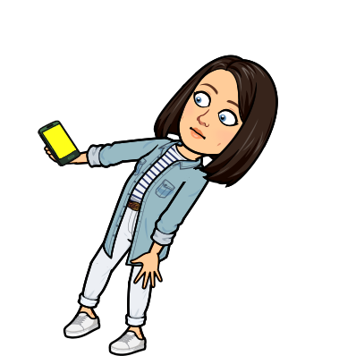
Emergency Contact Information
Please update your child’s emergency contact information on our website. This is very important so we have proper contact information as well as knowing who can pick up your child from school!
This should be completed by the first day of school, Monday August 24th

Slide 9
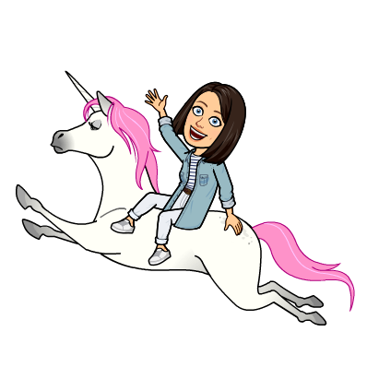
Update Parent Contact Information
I want to make sure I have everyone’s most updated contact information. If yours has changed, or changes in the future, please let me know ASAP so I can update my contact list!
The school will be sending out a lot of information this year through email. If your email has changed please let me know so I can update that as well ☺

Slide 10
Class Dojo
The whole school will be using Class Dojo this year.
I encourage everyone to download the App on your phone to view pictures, announcements, and see how your child is doing in class.
I will also be using it as a means of communication.
I will be sending out invites to join our class by Friday!

Slide 11
We can do VIRTUALLY anything! ☺
Thank you for joining me in this first ever Virtual Meet the Teacher.
Questions, Comments, or Concerns?

