Slide 1


iBienvenidos!

Slide 2

Mrs. Caldarelli
Mom of 2
Bachelors Degree
Elementary Education
Class Dojo for communication
Google Voice: 727-835-6670
jcaldare@pasco.k12.fl.us

Slide 3

Students must wear mask​
Recommend they wear one and have a spare in their backpack in case one gets soiled or misplaced.​
Recommend bringing a water bottle to eliminate the use of water fountains to drink from​
We will have one way hallways throughout the school​
Reducing the number of students at any given location​
Increase sanitation​
​
CONTACT ADMINSTRATION IF YOU HAVE FURTHER QUESTIONS ON THIS.​

Slide 4
You will be able to complete the emergency updated contact information on our website using a link.
We want to ensure we have proper contact information as well as knowing who can pick up the child. ​
This form should be completed before Monday, August 24th

Slide 5

We need their most updated email information. A lot of communication will be through email this year. ​
How your child is getting home from school the first day and then after that.
*TOUR OF CLASSROOM ​

Slide 6
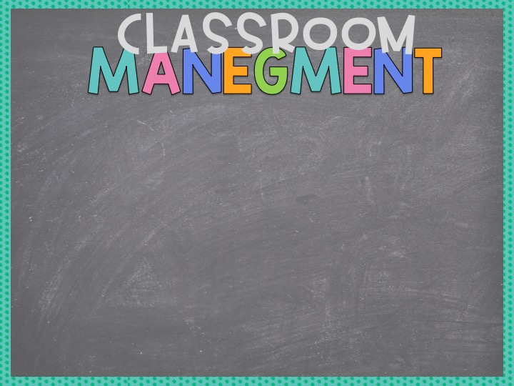
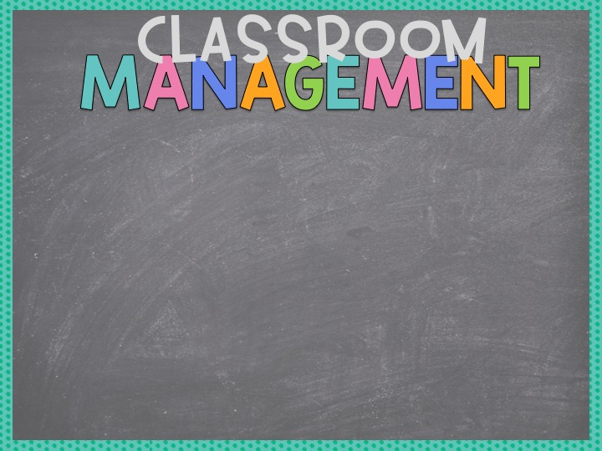
<Add Text Here>
Masks will be worn at all times
We will use Class Dojo daily
https://www.classdojo.com/invite/?c=CD4MFZXTi
Compliments
Celebrations
Lunch Buddies

Slide 7

All grades and communication related to student progress is done through the parent portal only.
Call the office or visit our website for directions on starting your parent portal account​
​
​Student fees of $29 can be paid online or by check. All students whose fees are paid by September 11th will receive a free RBCES t-shirt.​

Slide 8
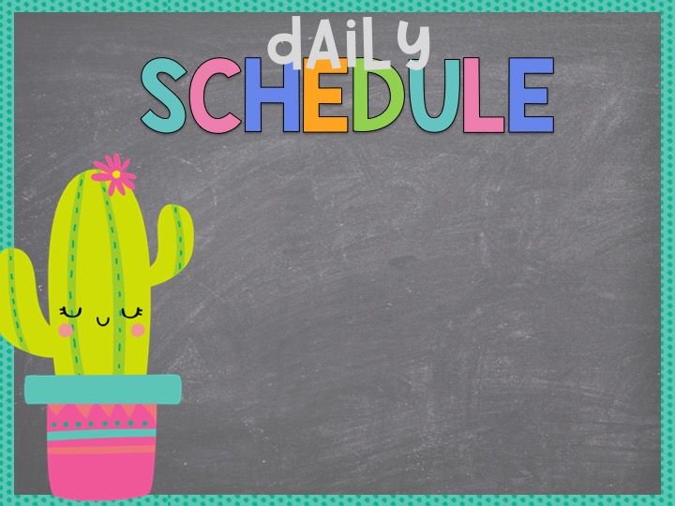
Time | Task
8:55-9:25 | IRLA
9:25-9:40 | Word Analysis
9:40-10:10 | ELA Whole Group
10:10-10:50 | ELA Small Groups
10:50-11:15 | Writing
11:15-11:45 | Tier 3 Reading
11:45-12:05 | Recess
12:06-12:36 | Lunch
12:40-1:55 | Math
1:55-2:20 | Science
2:20-3:05 | Specials PE/PE//PE/ART/MUSIC
<Add Text Here>

Slide 9

<Add Text Here>
DAY | SPECIAL
MONDAY | PE
TUESDAY | PE
WEDNESDAY | PE
THURSDAY | ART
FRIDAY | MUSIC

Slide 10

Monday through Thursday
Math daily
Reading comprehension passages
Writing Daily
Practice word analysis skills
We will be practicing writing cursive twice a week.

Slide 11

Because we have recess before lunch, students will wipe and sanitize their hands prior to eating.
Lunch will be in the cafeteria
MySchoolBucks starting August 15
Free or reduced meals application is online!
www.PascoSchoolMeals.com

Slide 12
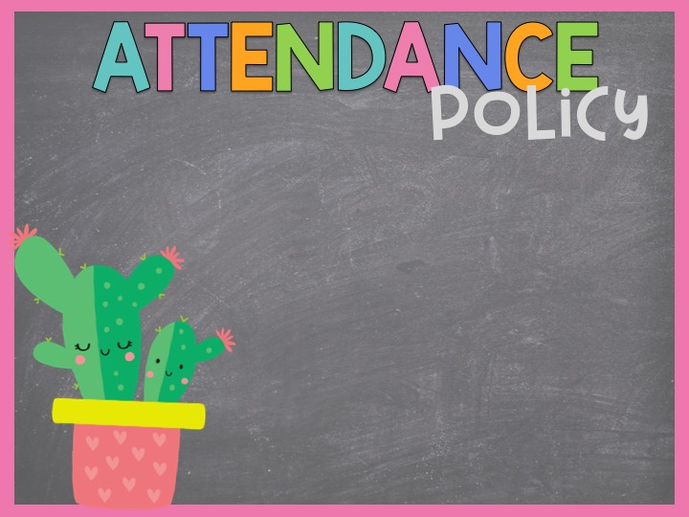
Please contact the office if your child will be absent
Please be on time. The late bell
rings at 8:40. After that, your child will be marked late.
.

Slide 13

The office will place a call
All students will be dismissed from
their classrooms.
There will be a call per bus.
Bus routes are available on the parent portal​
Car tags will be distributed Friday, August 21st from 10:00-1:00 at the car loop.
Parents picking up on Monday without a car tag will need to wait and be verified before child is released.

Slide 14

We will follow the Canvas course from Pasco.
We will supplement language lessons with Word Analysis lessons from ReadyGen.
Math: following Eureka Modules
Science: Discovery Education in Spanish and English

Slide 15

Word Analysis and Language Lessons Monday through Thursday
Weekly Exit tickets
Familiarize with verbs, adjectives, nouns, pronouns, parts of a sentence, parts of a word.

Slide 16

We will be using the Canvas course, along with DBQ passages to
learn Grade 3 reading standards.
Exit tickets will be done weekly to
gauge understanding and do
error analysis.

Slide 17

First weeks of instruction: Social Emotional writing
Writing assignments daily in Writing Notebook

Slide 18

We will follow Eureka Math for Grade 3.
Students will be given an initial assessment to see where they rate in basic Grade 2 skills
Groups will be created to
help students meet
grade level standards.

Slide 19

Students will have access to Discovery Education and will be assigned lessons throughout the units.
It is important they access and complete activities in a timely manner.

Slide 20

Water bottle daily
Masks: Preferably 5 to keep here
Individual pencil pouch
Individual crayons
Pencils
Glue Sticks
1 binder

Slide 21

Baby Wipes
Lysol Wipes
Hand sanitizer
Index cards
Paper towels
Post Its

Slide 22

August 24th: First Day of school!
IRLA leveling: 8/24-9/4

Slide 23

Virtual Field Trips only for 2020-2021

Slide 24

Please fill out volunteer forms. As of yet, we are not allowing outside adults into the school building, but things might change.

Slide 25

DBQ
DISCOVERY EDUCATION
RBCES’ WEBSITE
RBCES FACEBOOK

Slide 26

Although parents are not allowed to have lunch with their children, we can discuss a way to celebrate your child.

Slide 27


Slide 28
<Add Text Here>

Slide 29

<Add Text Here>

Slide 30

<Add Text Here>

Slide 31

<Add Text Here>

Slide 32

<Add Text Here>

Slide 33


Slide 34


Slide 35


