Slide 1
RBCES REGISTRATION 2020​

Slide 2
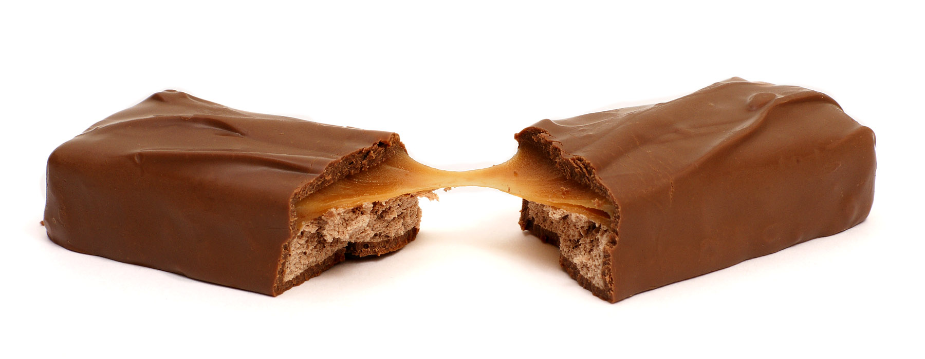
ABOUT MS. HERNANDEZ!
First year teacher
I am bilingual
I love drawing and eating chocolate
I have a dog
I am the oldest

Slide 3
CONTACT INFORMATION
Email: alhernan@pasco.k12.fl.us
Google voice number: (352)-403-0975
Class dojo

Slide 4
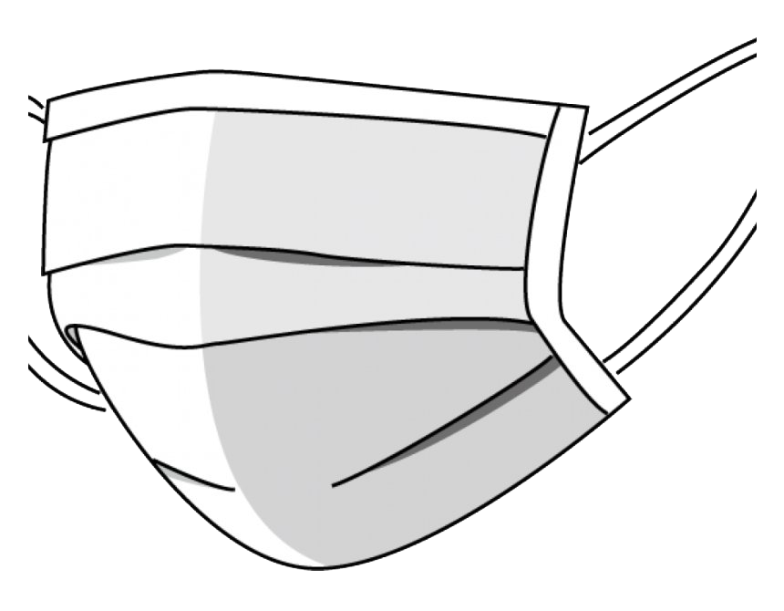
Safety Precautions
Students must wear face masks
Best if students have a spare mask in their backpacks
Water
To reduce use of water fountains water bottles are recommended
One way hallways
Number of students in given locations is reduced
Increased sanitation
Administration will answer any question regarding safety precautions and there is a FAQ for parents on our website

Slide 5
VIRTUAL TOUR

Slide 6
Ms. Hernandez’s class

Slide 8
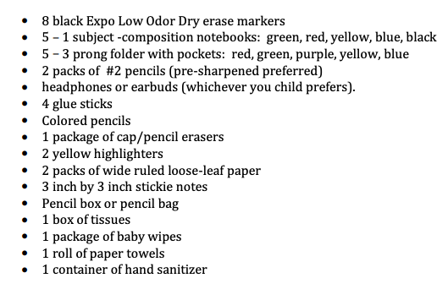
SUPPLY LIST
Supply lists can be found on our websites under the parents tab

Slide 9
TRANSPORTATION
Bus routes are available on the parent portal
Car tags will be distributed Friday, August 21st from 10:00-1:00 at the car loop.
Parents picking up on Monday without a car tag will need to wait and be verified before child is released.

Slide 10
Parent Portal & Student Fees
All grades and communication related to student progress is done through the parent portal only. Call the office or visit our website for directions on starting your parent portal account
Student fees of $29 can be paid online or by check. All students whose fees are paid by September 11th will receive a free RBCES t-shirt.​

Slide 11
Emergency Contact Information
Emergency contact information can be completed on our website using a link. This form should be completed before Monday, August 24th

Slide 12
Information needed before first day of school
We need the most updated email information. A lot of our communication will be through email this year.
The form your child will be getting home from school the first day and after that.
In the chat add student name, how they will be getting home the first day of school and rest of year.

Slide 13
CLASS DOJO
Download the Class Dojo app
Create an account in sign up or login if you have an account
Link: https://www.classdojo.com/invite/?c=CG8UER9

Slide 14
In the chat
Add your name, your students name, best way to contact you, current email, and telephone number.

