Slide 1
RBCES Registration 2020
1st Grade/Primer Grado
Ms. Sanchez

Slide 2
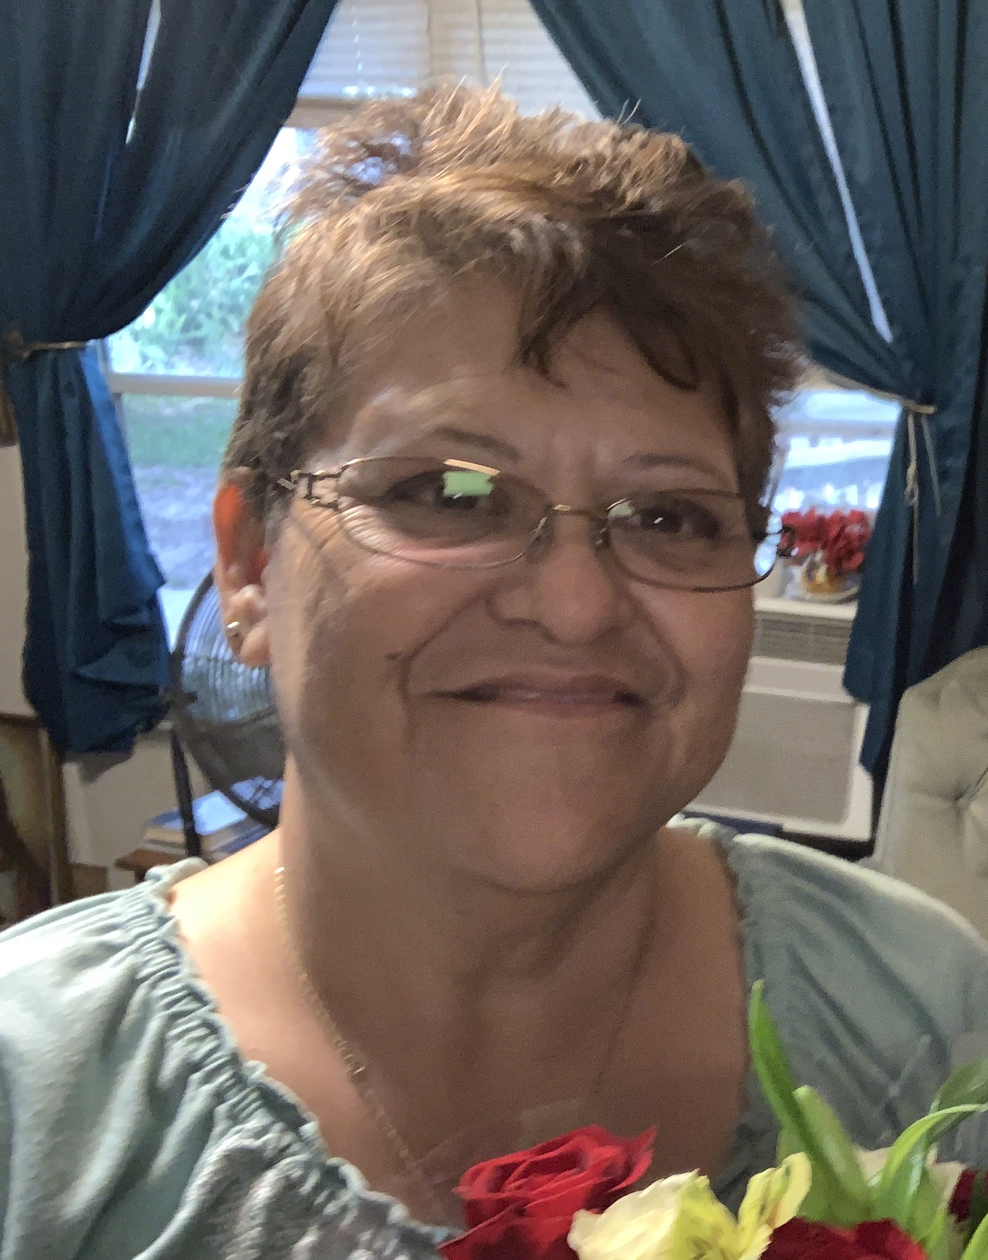
Ms. Sanchez
asanchez@pasco.k12.fl.us
Join me in ClassDojo
https://www.classdojo.com/invite/?c=CTSP7RX
352.584.2274

Slide 3
Safety Precautions
Students must wear mask
Recommend they wear one and have a spare in their backpack in case one gets soiled or misplaced.
Recommend bringing a water bottle to eliminate the use of water fountains to drink from
We will have one way hallways throughout the school
Reducing the number of students at any given location
Increase sanitation
Notes:
LET THEM KNOW TO CONTACT ADMINSTRATION IF THEY HAVE FURTHER QUESTIONS ON THIS. I DON’T WANT YOU TO GET IN THE WEEDS WITH THIS TOPIC. There will be a FAQ for parents on our website.

Slide 4
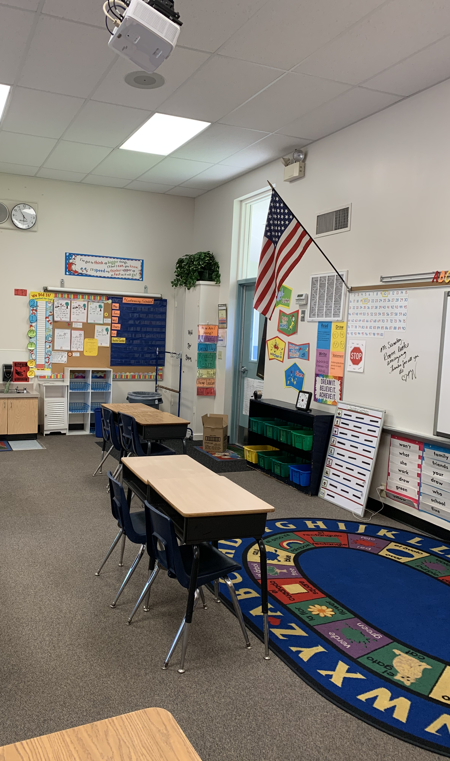
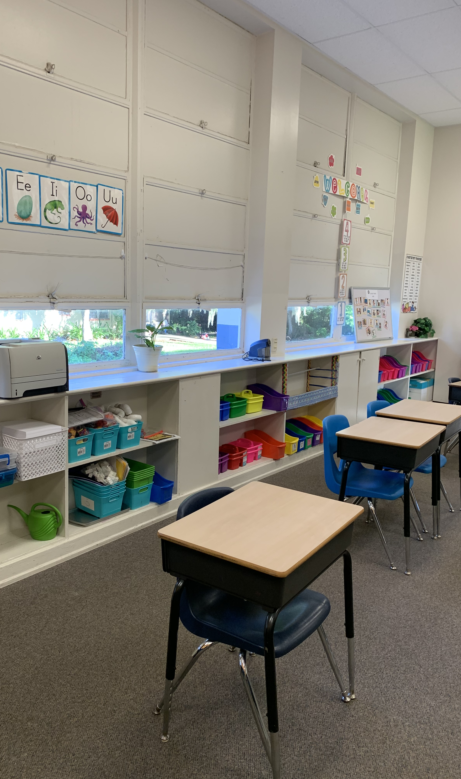
Mrs. Sanchez’s Classroom

Slide 5
Supply List

Slide 6
Transportation
Bus routes are available on the parent portal
Car tags will be distributed Friday, August 21st from 10:00-1:00 at the car loop. Parents picking up on Monday without a car tag will need to wait and be verified before child is released.

Slide 7
Parent Portal & Student Fees
All grades and communication related to student progress is done through the parent portal only. Call the office or visit our website for directions on starting your parent portal account
Student fees of $29 can be paid online or by check. All students whose fees are paid by September Student fees paid by September 11th will receive a free RBCES t-shirt.

Slide 8
Emergency Contact Information
Let parents know they will be able to complete the emergency updated contact information on our website using a link. Emphasize the importance of this as we want to ensure we have proper contact information as well as knowing who can pick up the child.
This form should be completed before Monday, August 24th

Slide 9
Information needed for August 24th Ask parents to send you the following information before the start of school.
We need their most updated email information. A lot of communication will be through email this year.
How their child is getting home from school the first day and then after that.

